Slide 1


Ocean
OTT System Introduction

Slide 2

01
System Features
of Ocean
CONTENTS
02
Architecture of
Ocean
03
Successful Case

Slide 3
«
01
System Features
of Ocean

Slide 4
Carrier-grade Solution
«
Carrier-grade and Expansible Solution
Separation of control and the media
High scalability
Cluster-based technical architecture and common hardware platform
Support million users scale
Provide a strong operating platform for content provider
Support distributed deployment
Carrier-grade System
Support VOD and Time-shifted TV
Support Live TV
Support to switch between diffrent rate
Strong
Basic Service Capability
High Availability
Provide redundancy backup of key
components
No single point of failure
With 99.999% reliability
Strong
Media Delivery Platform
Media delivery based on P2P
Irrespective with media format
Support mass storage and concurrent large-scale
streaming media
Support multi-level deployment

Slide 5
Carrier-grade Solution
«
OTT Platform Features
Live TV
Management and monitoring
Video on Demand
Manage VOD content, prices, covers, trailers and detailed information.
Catchup TV
Full automatization and workflow management.
Transcoding
Automated transcoding in cloud with different profiles and bitrate.

Slide 6
Carrier-grade Solution
«
OTT Platform Features
EPG
Management, manual or automated EPG import from Cloud.
Billing
Packages, Subscription periods with traditional or pre-paid subscribers.
Real-time & Detailed statistics
Advanced CDN, Devices and client statistics with usage and revenue reports.
Advertising
One click integration with 3rd-party Video Ads providers.
White-label solution
Easy to transform and customize.

Slide 7

OTT Market Requirement
There are two fundamental criteria any technology (OTT or IPTV) has to meet in PAY TV industry: reliability and quality.
signal may be delivered to different platforms: smartphones, tablets, game consoles, digital media boxes, STBs, etc.
OTT lets monetise on such value-added features as:
Real-time broadcast television and VoD
Time-shifted viewing of selected broadcast programs (nPVR)
Non-linear viewing (Time Shift / Pause Live)
Viewing of recorded programmes (Catch Up)
Smart recommendation and content search system
Integration with user accounts in social networks, ability to store user generated content and view it on various devices
Functionality described above requires cutting-edge technology and innovativ

Slide 8
«
OTT Market Requirement
Outstanding User Experience
High definition interactive content services
Whenever & wherever anyhow three in one screen application
Fluent and high-quality image quality
More nature interactive experience
Strong application expansion capability
Reliable & Stable Operation Platform
High-capacity: Millions of user scale, Magnanimous contents
High availability: Without single point of failure, Balanced
loading, Distributed deployment
High security: Support identification authentication; support
anti-stealing-link
Support multi-form: support various of forms from internet
Low-cost network deployment and smooth upgrade

Slide 9


Our advantage
Unique content
delivery network
(CDN)
Optimisation of network capacity without compromising video quality
Flexible approach to the needs of client infrastructure
Real-time monitoring

Slide 10
«
Our advantage
Adaptive HTTP streaming
This technology lets adapt video quality both inside and outside operator's network (i.e. in third party networks where quality of data streaming and network capacity can't be controlled or managed).
CDN
CDN is a link that connects data transmission system and client devices and applications.
Depending on user's location Smart Routing Engine routes the user to the best located server.

Slide 11
«
Our advantage
√
Video ultra-compressiontechnology(H.265)
√
Our compression technology stands out for its unique efficiency.
√
Our OTT solution uses different encoding profiles and therefore is available on various devices.
√
Network capacity requirements depend on the type of client's device and are within the following range: 0.3 — 0.7 Mbps for SD and 1.5 — 3 Mbps for HD.
Technology developed by LifeStream has an immense potential and may be deployed extensively: TV streaming on mobile devices, OTT, nPVR and user generated content.
√

Slide 12
«
Our advantage
Dynamic and flexible approach
Our solution represents a unique balance between quality standard (meeting all the requirements of the largest telecom operators) and individual approach to every project.
We are happy to provide recommendations from companies we are currently working with to demonstrate again efficiency of our approach.
We can also provide recommendations with detailed track record and project description.
Scalable solutions with reliability margin
Our company and solutions we design stand out thanks to their scalable nature and reliability margin, which is proven by project we implemented for clients servicing large audiences in 11 time zones.

Slide 13
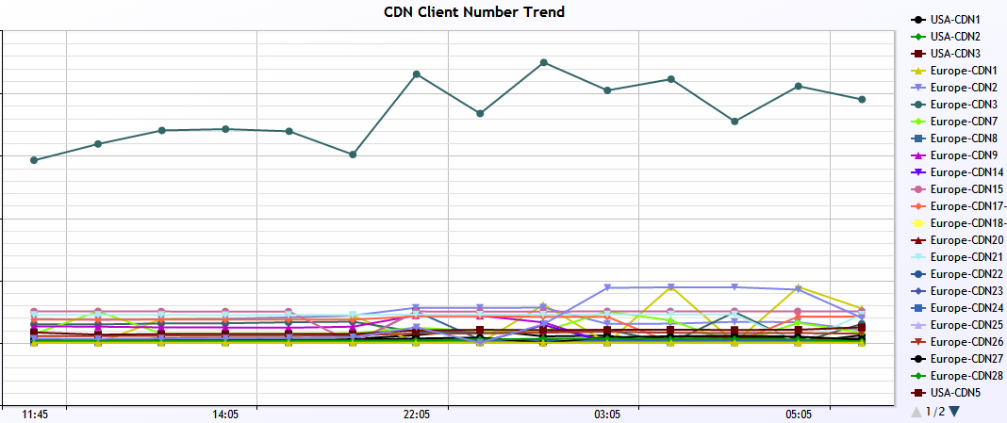
Monitoring
«
CDN Client Number Trend

Slide 14
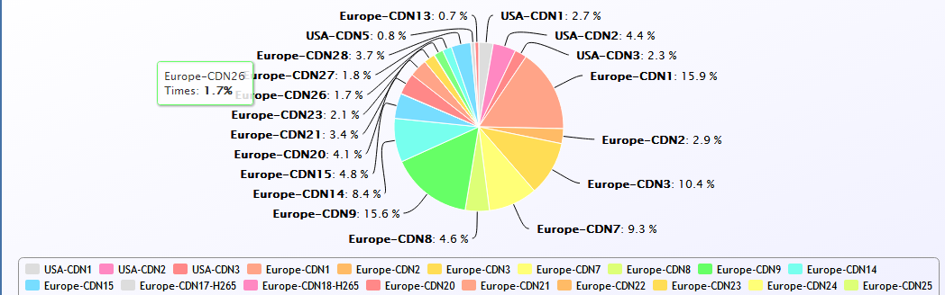
Monitoring
Program View

Slide 15
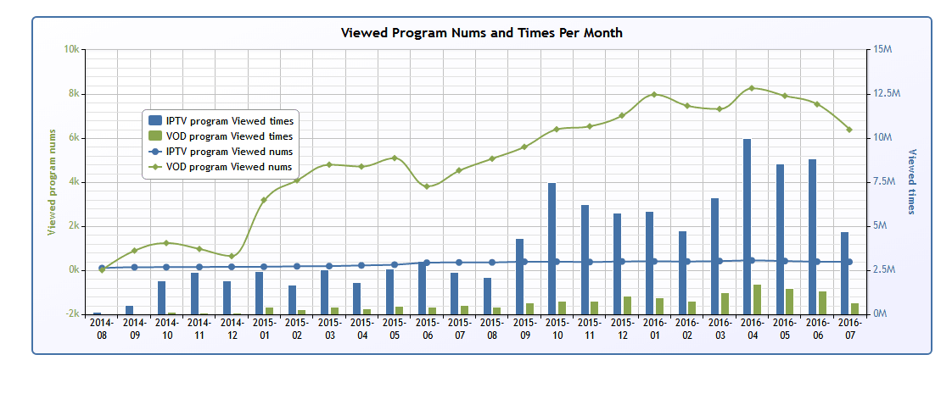
Monitoring
Program View

Slide 16
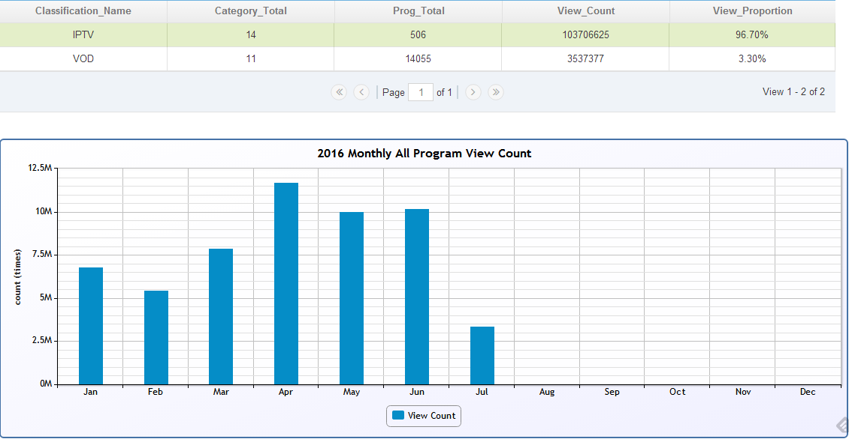
Monitoring
Program View

Slide 17
End to End Solution
Content management
User management
Service management
Billing center
Monitoring
BOSS &CMS of sites
Content
Provider
IP
TV
PC
Satellite
……
MPEG4
MPEG2
H.264
H.265
……
MPEG4
MPEG2
H.264
H.265
……
RTMP
RTSP
HLS
.......
STB
PC
Mobile
Phone
Terminal

Slide 18
Open Platform Solution
«
System platform irrespective of media
format
Support MPEG2 TS streaming
protocol
Support to interworking with current
OSS and billing system of operators
Open DRM Architecture, support to
integrate 3rd DRM
Open
Platform
Provide middleware of STB and system
EPG and portal UI is based on standard
WEB technology
Apply standard protocol interface
between equipments

Slide 19




«
Strong Service Support Platform
Rich Interactive Video Service and Value Added Service
Time-shifted TV
HDTV
Time-shifted TV
Time-shifted TV
nPVR
cPVR
TVOD
HDTV
MPEG2
H.264
H.265
Success
factors
Basic
Service
VAS
Basic Service
Live TV
VOD
Mosaic Channel
My favorite
Bookmark
VAS
Interactive Game
Interactive quiz
Distance learning
Vote
TVMS
Internet
Karaoke
Interactive discussion

Slide 20
System Redundancy & High Availability (HA)
High Availability
Contributions
Content
Redundancy
Inter-MSN
Redirection
NE
Redundancy
Port
Redundancy
Load
Sharing
Contents are
replicated in
slice on
multiple MSN. All replicas
are active to allow load
sharing
between
MSN
In case of a
MSN failure,
NE redirects
terminal
requests to
another MSN
holding
redundant
content
All NE (ICMS,
GSLB, MPT,
CMT, NM,
MSN)
features 1+1
or N+M
redundancy
All MSN has 2 GE ports
and features Port failover
redundancy
Load-sharing
structure is
adopted on
GSLB, ICMS,
MPT to
maximize
performance
while providing
mutual backups

Slide 21
«
02
Architecture of
Ocean

Slide 22
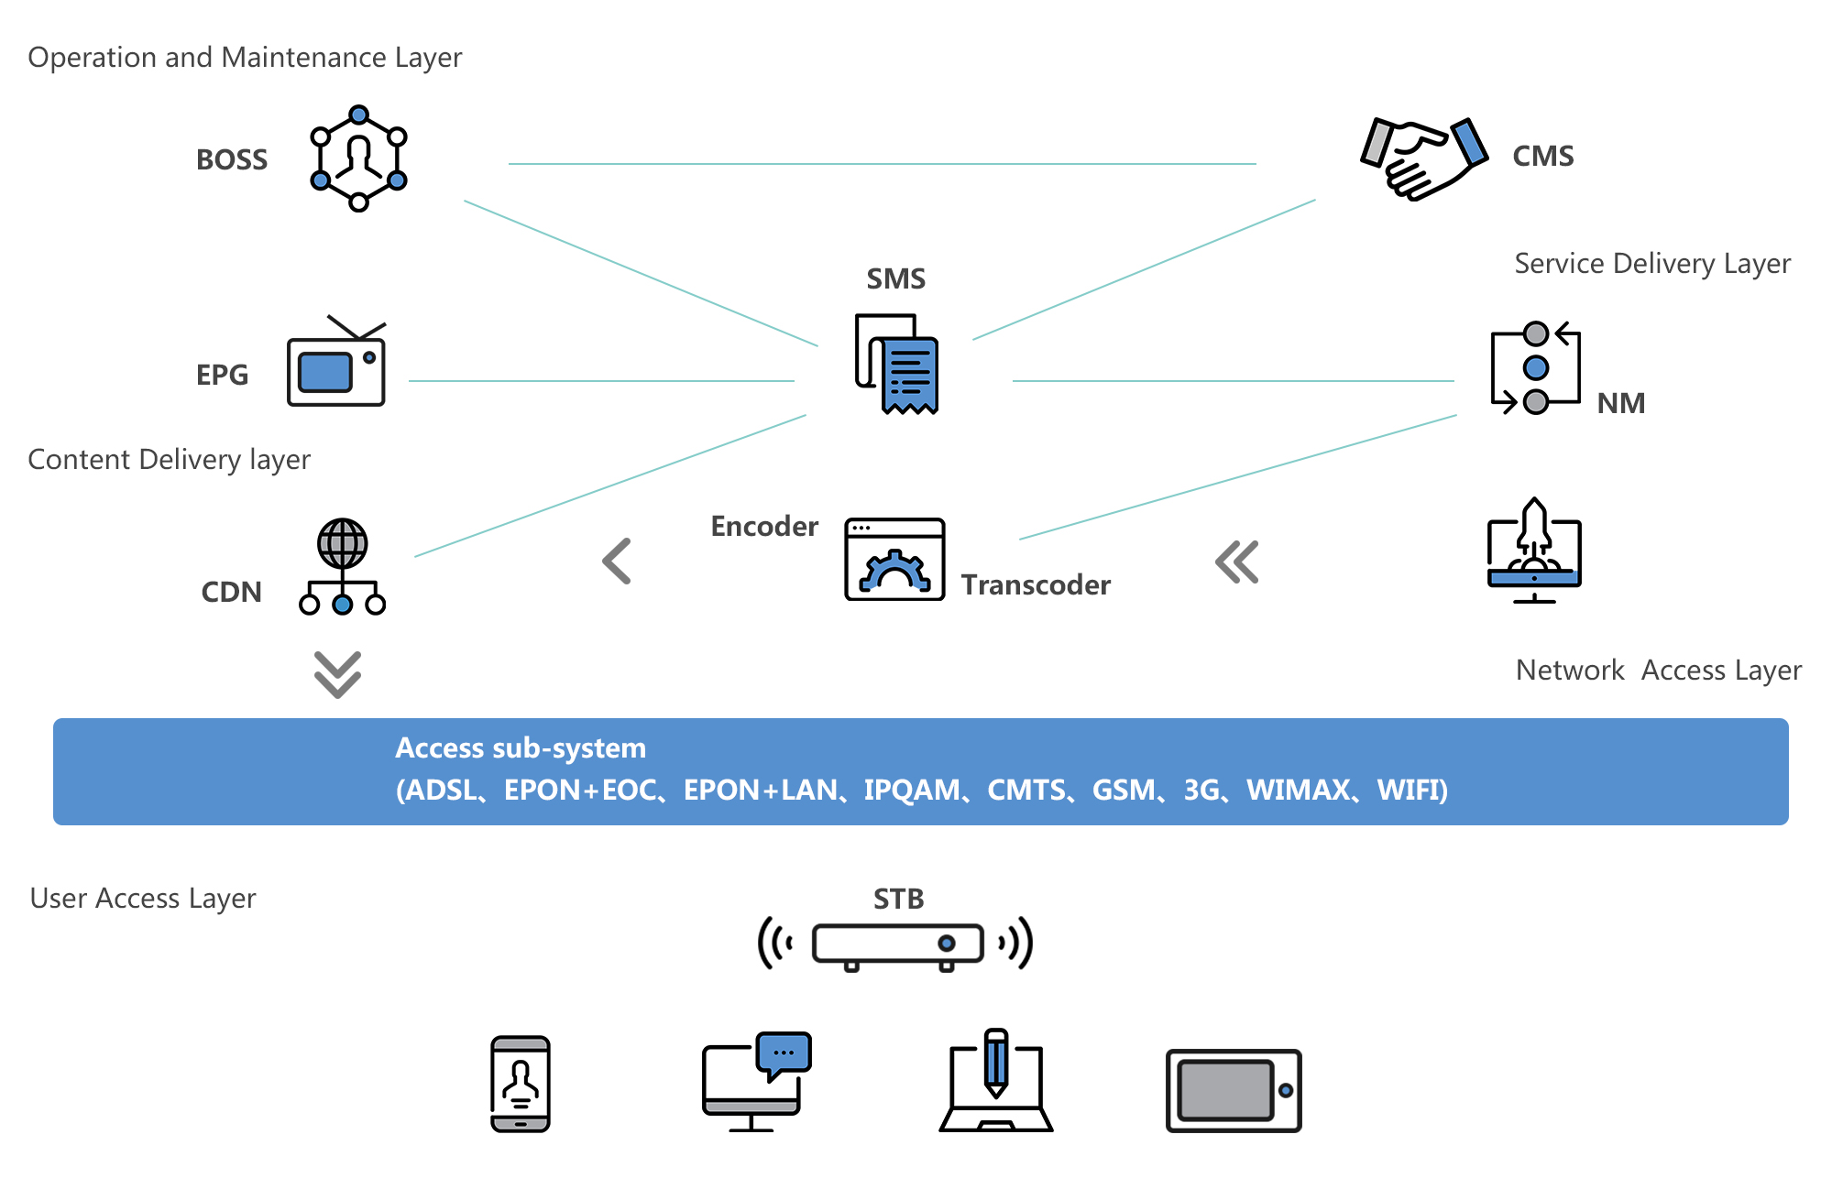
Architectur of Ocean IPTV System

Slide 23
System Architecture
Core components
of system platform
Live Telecast signal
VOD Movie
SP、
CP、Operatos
BOSS
CMS
1
Content Management System
(CMS)
Business Operation Support System (BOSS)
Service Management System
(SMS)
Content Distribution Network
(CDN)
Electronic Program Guide
(EPG)
Network Management System
(NMS)
NMS
SMS
2
EPG
CDN
3
4
Access subsystem (ADSL、EPON+EOC、EPON+LAN、IPQAM、CMTS、GSM、3G、WiMAX、WiFi)
5
Teminal Subsystem
6

Slide 24
Content Management System (CMS)
«
CMS
BOSS
SMS
CDN
EPG
NMS
Information management
Responsible for the management of
content metadata, namely content
description information, including the
content audit、content distribution 、
content maintenance etc.
Content distribution management
Operation support system
According to heat of content and
state of SP resource, adjust the distribution of content dynamically, in order to distribute content dynamically in the whole network.
SP content
management
Log,
statistical
report
Metadata
Maintenane
Audit
Broadcast
Information
Heat statistics
Distribution
maintenance
Content distribution
management
EPG system
Streaming media service system
EPG management
According to the published content,
automatically update EPG template
and content, provide kinds of combined
search criteria to positioning and
retrieve according to given conditions.
User authority management
The system supports four-stage users,
they are super administrator, operator,
SP operator and SP administrator ,
each one is assigned different
permissions.
Content manufacture system

Slide 25
BOSS - Subscribers Management
«
CMS
BOSS
SMS
CDN
EPG
NMS
Subscribers account opening, activation, deactivation
Service subscriptions definition, effective and query
Support SOAP interface integration with the third party system
Set subscribers’ charging parameters
Support content classification setting
Support operation test account
Functions of service management subsystem for subscribers:
Provides a GUI for the service provider to maintain subscribers’ information easily.
Details lists and service information query
Historical billing query
Purchase channels and content service
1

Slide 26




BOSS - Authentication Management
«
CMS
BOSS
SMS
CDN
EPG
NMS
Authentication
Supports username/password authentication, binding authentication etc..
Billing
Collects subscribers’ original data (such as time and flow), generates records of consumption and submits to BOSS for accounting. BOSS will reconcile with SP, and pay with SP according to the settlement rules that development with SP/CP.
CP/SP management
Includes basic information management, life-cycle management, credit control management etc..
Statistical analysis
Analyses basic information of subscribers, and provides corresponding report
Analyses program resources, user demand info, and provides corresponding report
Analyses marketing, and provides corresponding report;
Colligation statistic based on other conditions, provides reliable basis
for decisions
Preprocesses and censuses the system data, improves processing efficiency
of follow-up report.
3

Slide 27

CDN – Streaming Services
«
CMS
BOSS
SMS
CDN
EPG
NMS
Content delivery.
When used, CDN functions within service platforms grouped geographically and located in the closest proximity to end-user.
Offloading streaming servers.
Instead of addressing streaming servers clients are routed to CDN servers thus decreasing the load on broadcasting system.
Support of popular broadcasting formats.
Our solution supports all popular formats including widely used HLS system. We also support linear (live broadcasting) and nonlinear (including VOD) viewing. Also compatible with client apps.
2

Slide 28
Service Management System (SMS)
«
CMS
BOSS
SMS
CDN
EPG
NMS
Authentication
Authorization
Accounting
Recording user bookmarks
and collecting personalized
information.
Supporting STB access,
AAA able to authenticate
the user, and will based
on the user group and other
attributes assigned a list of the corresponding live channel after the
authentication successfully.
When user request any content,
AAA will base on the user and
user's ordering relationship
complete the authentication
automatically.
If the authentication is not passed,
the AAA will base on the user's
product package structure, return
to the product list for the user to
order to EPG, and guiding the
user to complete the order.
Once the order is successful,
the AAA can record the order
relationship automatically, and
generate the order records.
And also be able to
record, query the user
log on demand, to
generate a detailed
list of user orders and
billing.
With billing functions,
to ensure the billing
result accurate and
detailed.

Slide 29

«
CDN – Content Management
CMS
BOSS
SMS
CDN
EPG
NMS
Open architecture.
CDN is a link that connects broadcasting system and client devices and applications. Instead of addressing streaming servers clients are routed to CDN servers. Users are routed to Edge servers by Smart Routing Engine depending on users' geographical location and status of their networks.
Specifically optimised streaming network.
Video streaming network built especially for OTT and IPTV. CDN may also be used to transmit any static data like any conventional CDN.
Technology.
CDN's Smart Routing System ensures the most efficient content delivery decision based on users' geographical location and status of their network. Our CDN ensures content transmission via service platforms located in the closest proximity to end-user.
3

Slide 30
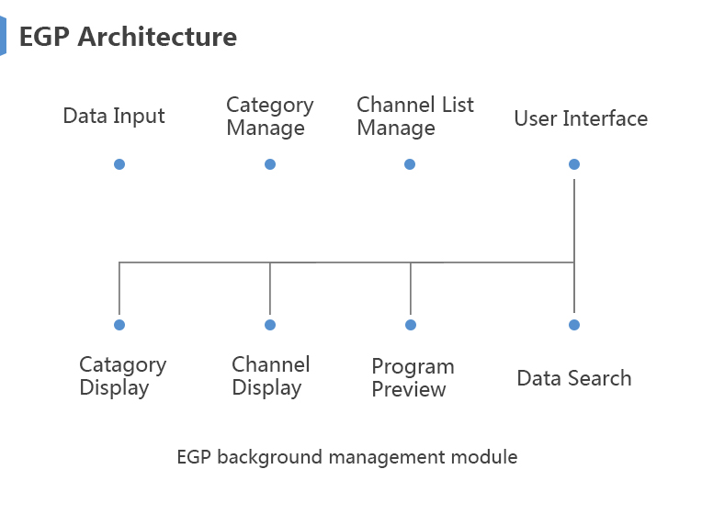
«
Electronic Program Guide (EPG)
CMS
BOSS
SMS
CDN
EPG
NMS
The EPG subsystem provides for the end user consumption
guidelines, the main functions include:
EPG page function
Program playlist function
Show additional information function
Program classification function
Business search function
Business navigation function
Program reservation function
Parental hierarchical control function

Slide 31
«
Electronic Program Guide (EPG)
CMS
BOSS
SMS
CDN
EPG
NMS
The web-based EPG allows subscriber to browse and purchase programs. The EPG can be easily customized in different site, and subscribers in different groups are provided with different EPGs.
Gets metadata information from NMDB and then generates dynamic EPG pages for subscribers. The EPG pages can be easily customized according to subscriber’s demand.
The EPG used for the streaming service is browser-based.
Full motion video can be embedded in an EPG page.
Browser page can also be overlaid on top of a full motion video.

Slide 32
«
Network Management System (NMS)
CMS
BOSS
SMS
CDN
EPG
NMS
Abides by ITU-TM.3010
standard specification
Abides by China Telecom IPTV2.0
standard
Supports interface of Web Service
Adopts Browser/Server structure, completely achieves
network management functions that defined by
international standard organization, such as TMN
(Telecommunication Management Network), the functions include fault management, configuration management, performance management, security management and user management.

Slide 33



Network Management System (NMS)
CMS
BOSS
SMS
CDN
EPG
NMS
Fault Management
Real-time alarm/ event monitoring, history alarm management
Fault diagnosis and location
Alarm filtering, severity define, confirm and clean up
Automatic alarm and event processing, analysis of correlation and causes
Performance Management
Real-time performance monitoring on PC server and streaming media service
Performance management over-limit
Statistics on performance , trend analysis and network
optimization of network element
Configuration Management
Automatic discovery
and configuration management
Software upgrade
and patch
management
Control and file the ystem log and user operation log

Slide 34
Media Assets Management System (MAM)
Program source through the Media Assets Management System, the Content Injection Management System and the
Content Checking System can send the related service to every platform and program equipment.
A process of the program source from input to output:
Program injection system supports local channel services injection and third-party services integration, finally reaching
the entrance of each business via a unified standardized data format SOAP.
BesTV/CNTV
Provincial
TV stations
PPStream
TV content interface
Radio content interface
Internet contentinterfae
Metadata
management
Content integrate and import system
Uniform
interface
SOAP
(XML/FTP)
CP/SP
Service provider
VSP
Content injection
management
CP/SP portal
Service provider portal
VSP portal
Program exploder
Program exploder
XX content platform
XX content platform
Content checking

Slide 35
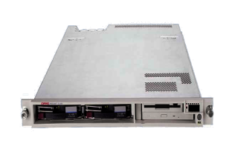
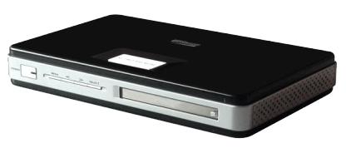
Hardware Platform
Content-Encoding Transcoding System:
Real-time encoding, transcoding and transmission
Analog and digital video input
Support MPEG2, MPEG4, H.264, H.265 etc video encoding format
Support MP2, MP3, AAC, WMA, AC-3 etc audio encoding format
High bit rate (up to 6Mbps) and low bit rate (as low as 750kbps)
video encoding
Support hot swap and backup
CTLoader Cluster
Media Delivery System:
Cluster based system design
non-blocking service mechanism for large-scale users
Support M3U8, RTSP, web service, mP2P, SDFS(GFS-like)
Complete fault-tolerance
GSLB Cluster
MPT Cluster
ICMS Cluster
HLC Cluster
HLS Cluster
Terminal:
Broadcast video quality
Middleware based software architecture
Totally online software upgrade capability
Full HTML embedded browser
Support video communication
Terminal

Slide 36
«
03
Successful Case

Slide 37

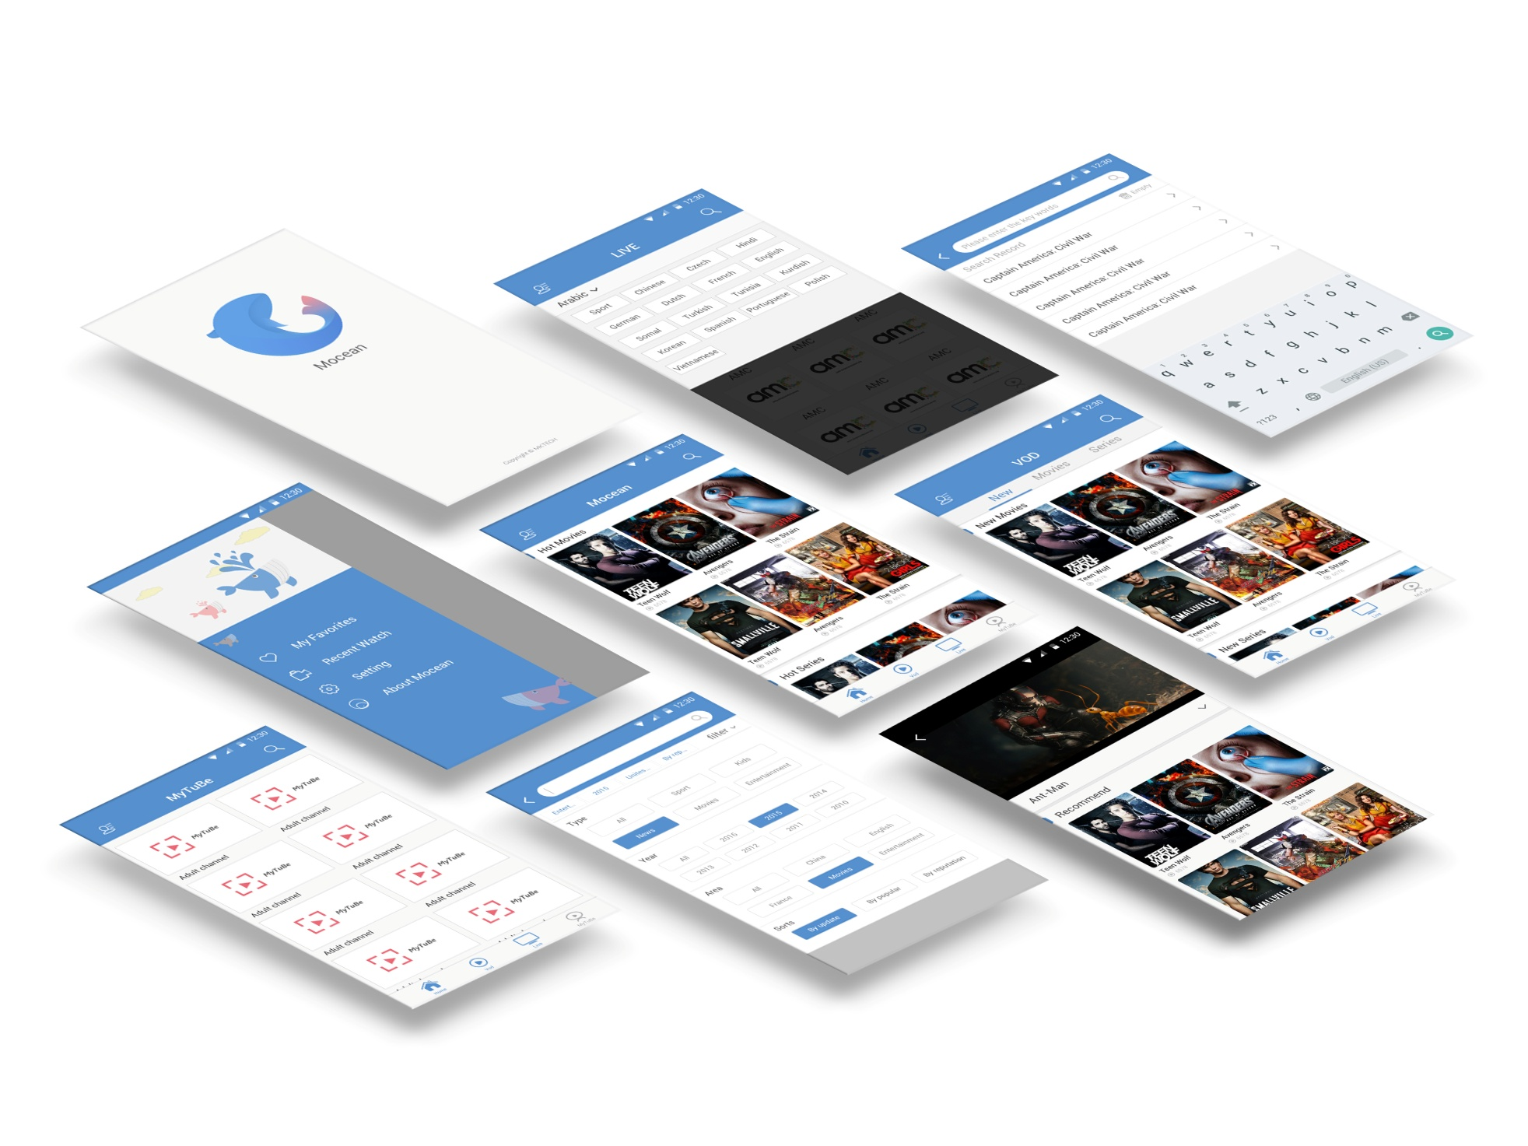
Successful Case
Client
Of Ocean

Slide 38
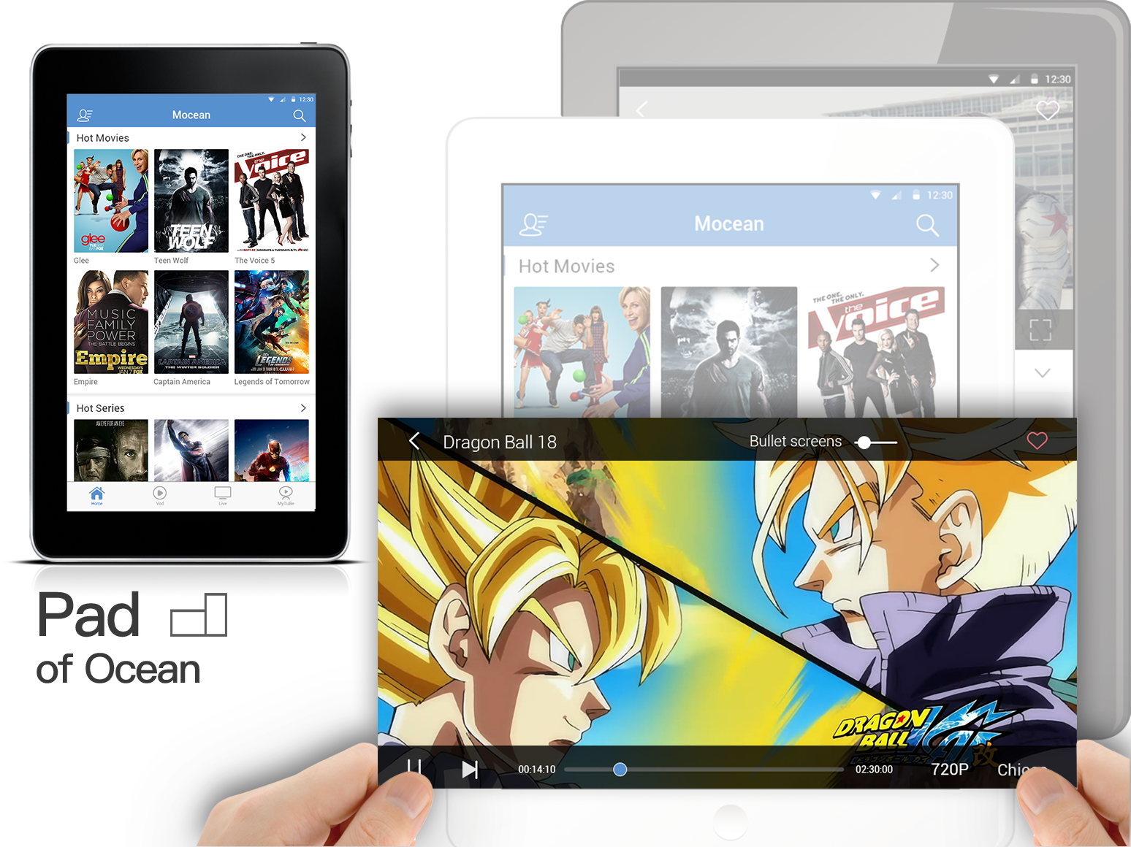
Successful Case

Slide 39
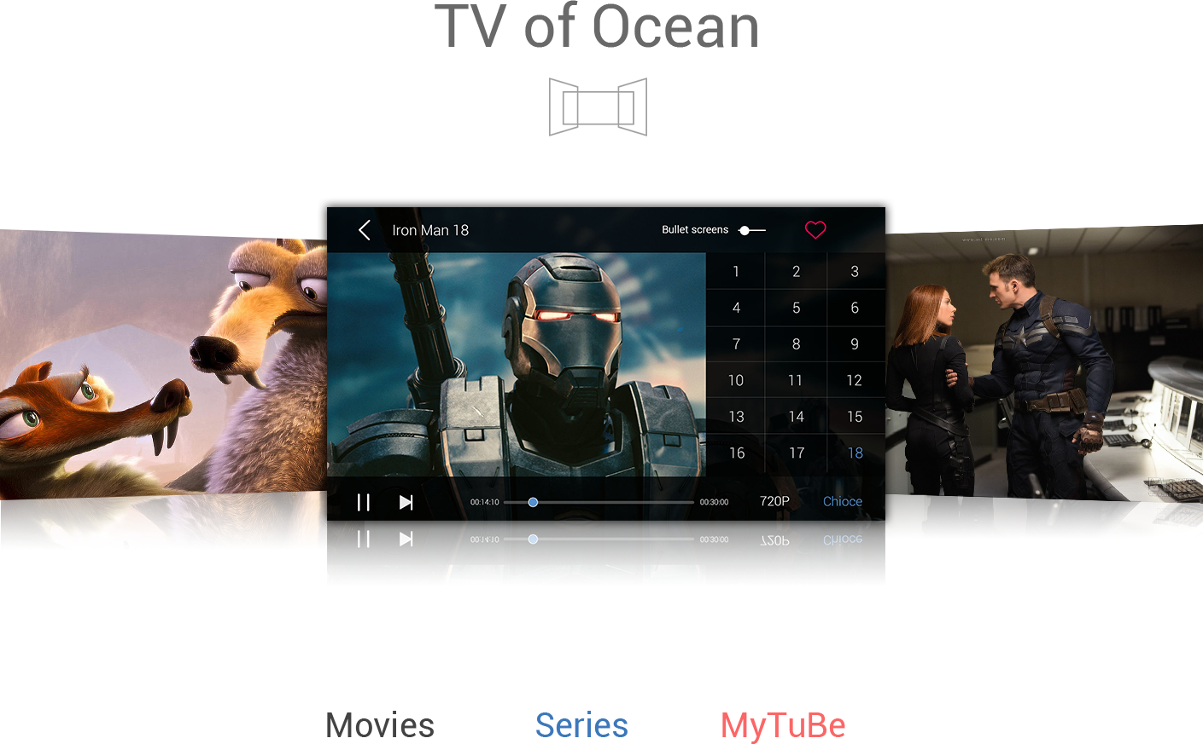
Successful Case

Slide 40
Successful Case
1st
Intelligent content distribution/caching minimizes network overhead
Intelligent
Carrier-class Reliability
2nd
With chassis-based, Telco-grade comprehensive solution with system wide redundancy
Excellent
Scalability and
Flexibility
3rd
With distributed or central architecture, allowing
incremental system expansion by either increasing the size of clusters or by deploying new MDS
4th
Offer Live TV, VOD, Time-shifted TV, Network PVR, NVOD/PPV, Virtual Channel, gaming and etc.
Rich Applications and VAS
5th
With open system architecture, avoiding multi-vendor integration nightmare while allowing specific 3rd party best-of-breed vendor interoperability
Fully Integrated End-to-end Solution

Slide 41
Thanks

